Slide 1
Scientific Conference on “Applicability of Radiation Response-Models to Low Dose Protection Standards” Cosponsored by the American Nuclear Society and Health Physics Society Pasco, Washington State, USA; September 30-October 3, 2018
Protection against Exposure to Low-dose Radiation:
An Evolving Paradigm Sustaining Regulatory Decisions
Patricia WIELAND^{[1]} & Abel Julio GONZÁLEZ^{[2]}
[1]World Nuclear University; Tower House; 10 Southampton Street; WC2E 7HA - London, UK.
[2]Argentine Nuclear Regulatory Authority; Av. del Libertador 8250; Buenos Aires; Argentina.

Slide 2

We face a conundrum

Slide 3


Slide 4
Our conundrum
Should people be protected against low-doses however small?
or, conversely,
Should low-doses be ignored or even welcomed?

Slide 5
Current radiation protection paradigm
Recommended by the International Commission on Radiological Protection (ICRP)
Globally established by international standards issued by intergovernmental organizations

Slide 6
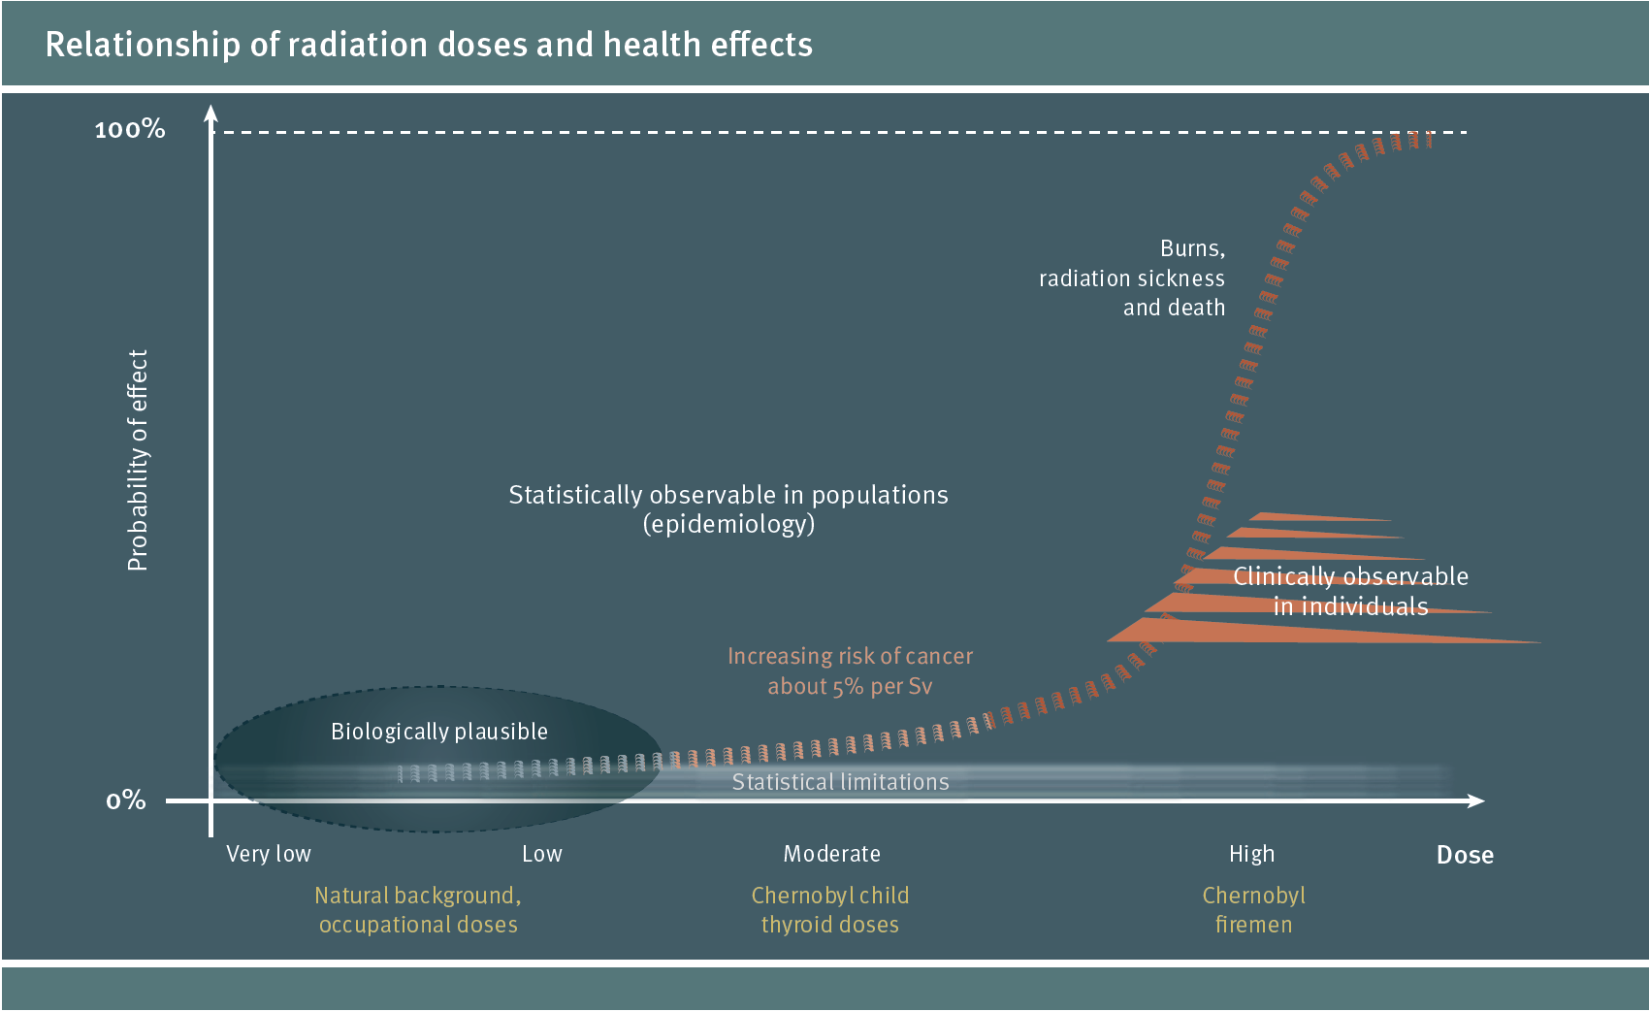
6
Notes:
6

Slide 7
For low doses, the paradigm is based on radiation risk estimated by extrapolation of high-dose data.

Slide 8
Thus, the ICRP has considered that, while the existence of a low-dose threshold is not seen as unlike, the paradigm concludes that available epidemiological data does not favour a universal threshold for prospectively inferred risks at low doses.

Slide 9
Therefore a dose response model, confusedly termed ‘linear-non-threshold’ (or LNT), was recommended as a prudent premise for radiation protection at low doses.

Slide 10
10
Notes:
10

Slide 11
Postulated nominal risk
Nominal Risk 5%/Sv
Total
background incidence of effects
Nominal incremental
risk
Incremental dose
Dose
Background
annual dose
(average 2.4,
typical 10 mSv y⁻¹)
11

Slide 12
As it could be seen, the model is in fact more subtle than ‘LNT’:
it postulates that at low doses an increment in dose above background might imply a directly proportionate increment in the subjective probability of incurring effects, with a calculated detriment-adjusted nominal subjective probability (risk) coefficient of around 5% per sievert.

Slide 13
The postulation is needed for radiation protection purposes because it allow partial incurred doses to be summed up.
Otherwise the current radiation protection standards would be extremely complicated and probably not acceptable to workers.

Slide 14
However, this extrapolated and subjectively estimated probability, only recommended for radiation protection purposes, has been used to calculate factual health effects attributable to low doses.

Slide 15
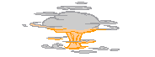
Modeling
Collective doses
Discharges
Notes:
15

Slide 16
X
5%/Sv
=
Collective Dose x Nominal Risk Coefficient = Nominal Deaths
Notes:
16

Slide 17
Theoretical assessments of effects based on such assertion have been widely performed by scientists and academies

Slide 18
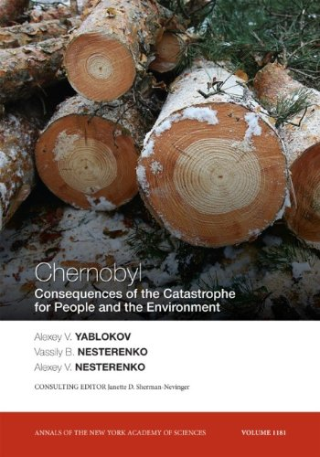
Annals
of the
New York Academy of Sciences
It concluded that some 985,000 people died of cancer attributable to the Chernobyl accident!
18
Notes:
18

Slide 19
This misuse has been an epistemological error amply discussed in the literature.
Such blunder caused much damage and had triggered calls for action…. ….including this Conference

Slide 20
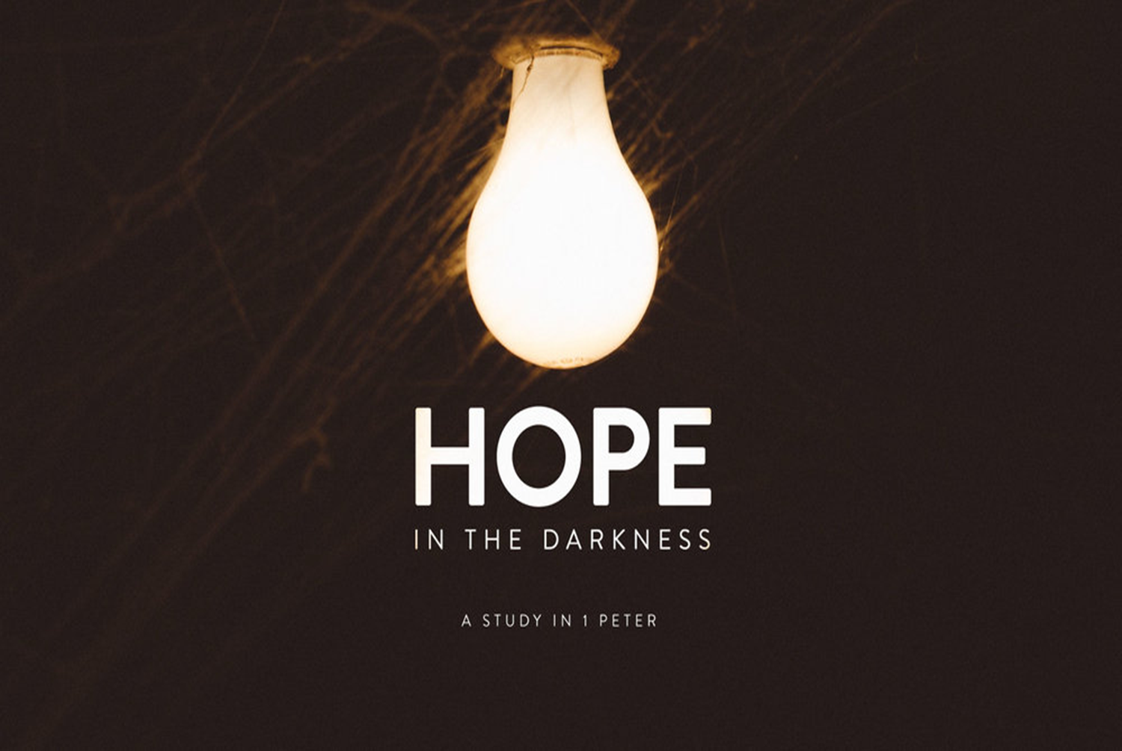
News from the United Nations!
TO RESOLVE THE CONUNDRUM?

Slide 21
Few years ago, the United Nations General Assembly (UNGA) decided tackling the objective attribution to radiation of factual health effects vis-à-vis the subjective inference of potential radiation risks.

Slide 22

A recent report from the United Nations is providing fresh information on this conundrum.
The reports are from a prestigious body of the UN General Assembly:
The United Nations Scientific Committee on the Effects of Atomic Radiation
22

Slide 23
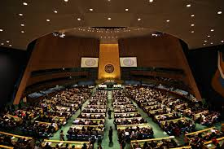
UN General Assembly: 193 States

Slide 24
UNSCEAR published (and the UN recognized) a comprehensive report that reflects an evolving paradigm.

Slide 25
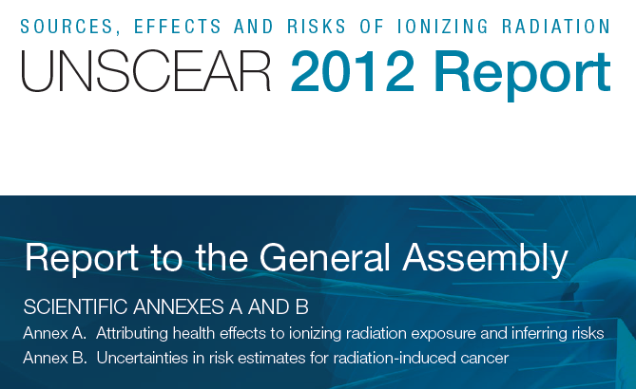

Slide 26
Subjective
conjectures
Objective facts
26
Notes:
26

Slide 27
Objective attribution of effects
Subjective inferences
Subjective
conjectures
Objective facts
27
Notes:
27

Slide 28
The reader digest’s of UNSCEAR outcomes:

Slide 29
Health effects cannot be attributed to chronic exposure to radiation at levels that are typical of the global average background levels of radiation.

Slide 30
Hereditary effects in human populations cannot be attributed to radiation exposure.

Slide 31
In short, this evolved paradigm reflect a new international consensus achieved at the highest scientific level within the United Nations system, which:
distinguishes the objective attribution of health effects to retrospective exposure situations from the subjective inference of plausible risks from prospective exposure situations; and,
concludes that
increases in the incidence of health effects in populations cannot be attributed to low-doses, but
risk from planned situations may be prospectively inferred for purposes of radiation protection and allocation of resources .

Slide 32
Then,
Can science resolve the issue of how to regulate low-radiation doses?
Our suggestion is that science can help but can not resolve the issue

Slide 33
The objective attribution of health effects to low-dose (whether negative, positive or neutral effects) falls out the remit of the relevant sciences because of epistemological limitations.

Slide 34
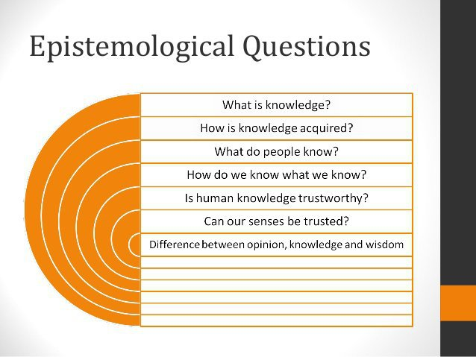
.

Slide 35
Radiobiology can provide robustness for subjective inferences of probable outcomes but cannot attribute effects.
Attribution require:
For individuals: unambiguous diagnosis from radiopathology (which is impossible at low dose because of the lack of biomarkers)
For populations: robust conclusions from radioepidemiology (which is impossible at low doses because of statistical constraints)

Slide 36
The low dose conundrum require regulatory rather than scientific solutions, a fact that had been recognized already 20 years ago, but to no avail.

Slide 37
Epilogue
The way ahead

Slide 38
Low-dose protection standards should be based on legislative and regulatory decisions rather than on radiation-response scientific models.

Slide 39
The time seems to be ripe:
for legislators to use the well-established legal concept of ‘de minimis non curat lex’ and exclude from the law low-dose exposure situations that are unamenable to be controlled, and
for regulators to use the old concept of ‘de minimis non curat prætor’ and exempt from regulations low-dose exposure situations that do not warrant control.

Slide 40
Legislators and regulators ought to convert the new international consensus paradigm arising from the new UN conclusions on attribution into commensurate instruments for regulating low-dose radiation exposure situations.

Slide 41
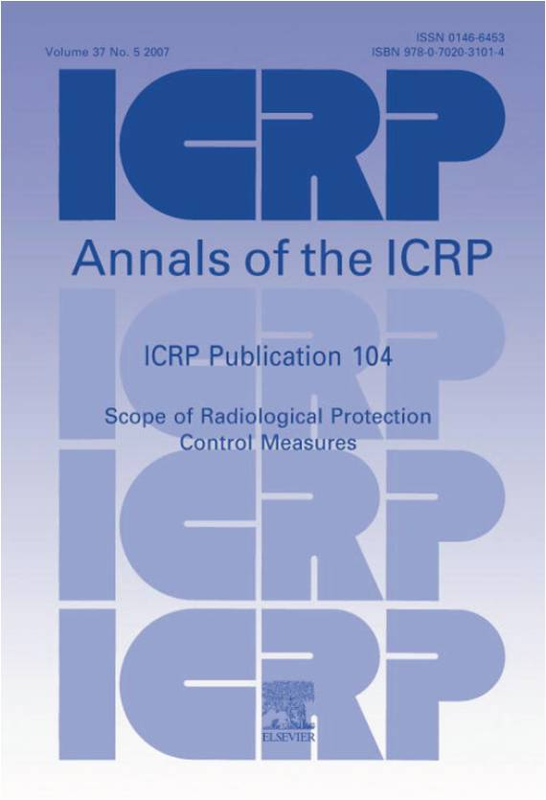
ICRP may be of help, but how long would it take?

Slide 42
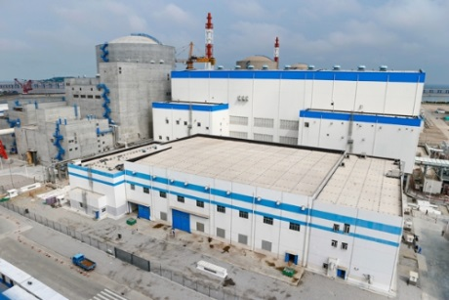
Sustainable energy = nuclear + renewables
Fast forward to low carbon generation

Slide 43
Maintaining safety while ensuring good health & wellbeing
Safety remains a basic foundation of the nuclear industry
The Optimization Principle (namely, the best protection under the prevailing circunstances – and not necessarily ALARA) is being misapplied for low doses of radiation, which results in:
Resource intensive burden to eliminate small risks
Mistrust in the system of radiological protection

Slide 44
Holistic approach
Risks subjectively associated with low radiation doses should be put into perspective to allow a balanced judgement of objective benefits e.g. carbon reduction!

Slide 45
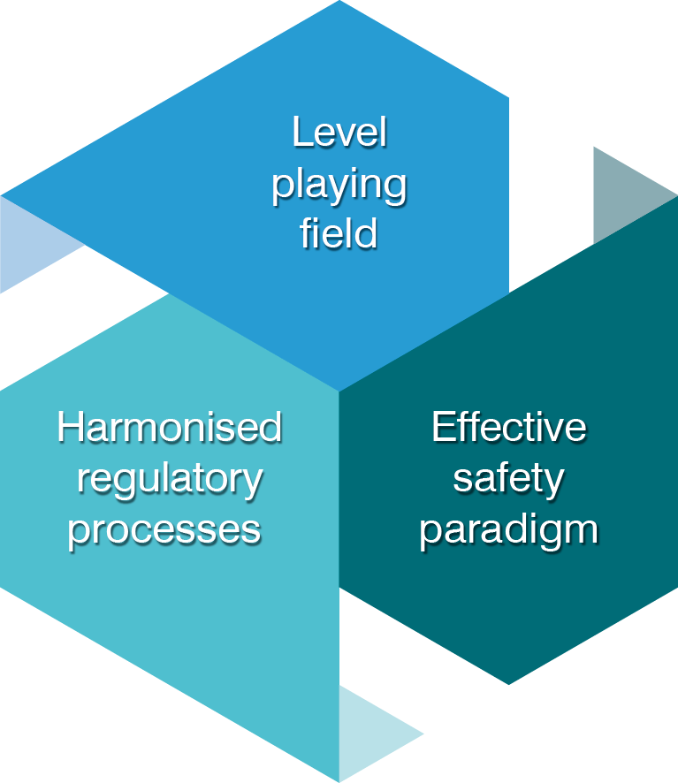
Harmony: effective safety paradigm
Create an effective safety paradigm focusing on genuine public wellbeing, where the health, environmental and safety benefits of nuclear are better understood and valued when compared to other energy sources

Slide 46

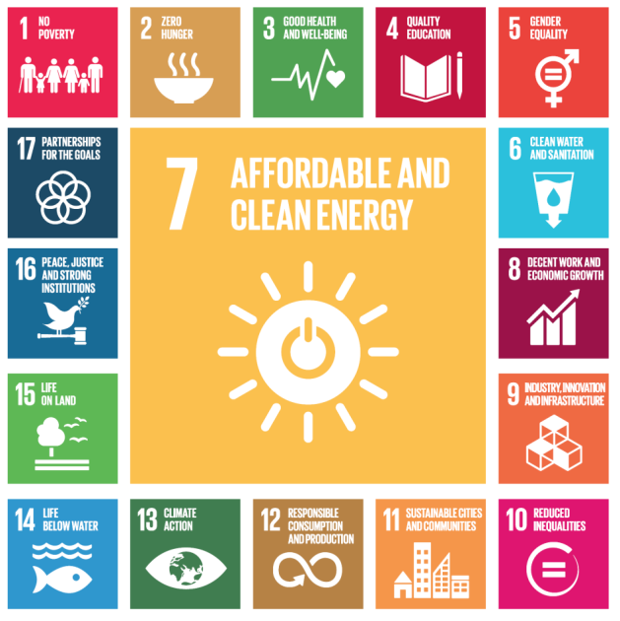


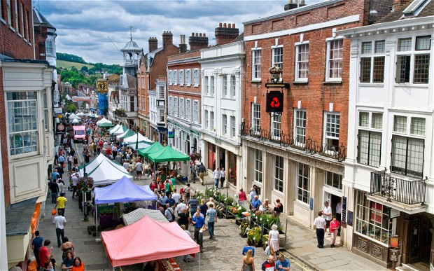
Effective safety paradigm
Active in communicating the real-life benefits it brings to people.
Healthy environment
Jobs
Put into effect the international consensus on the effects of low levels of radiation exposure.
Open space
Local economy

Slide 47
Easier if it happens with others?
People suffered for life because of the 1 mSv evacuation level in Japan.
As an expert, how much radiation dose would you accept for yourself and your family for not being evacuated?
We need to protect the public against
the perception of radiation!

Slide 48
Average Occupational Exposures in Different Sectors

Slide 49
Developments led to reduction of doses, while the RP system remained too conservative
Better Infrastructure for radioactive source safety
Specific requirements for construction and operations
More accurate and real time dose measurement
Radiation detectors
Real time monitoring systems; drones
Modeling, computers; Data base, PRA
Regulatory bodies
National registry of sources and doses
International cooperation/Regional Forum of regulators
Human resources
Safety culture/Continuous Training; e-learning platforms
Competent operational personnel
Better prepared managers for planning and decision making

Slide 50
Call for actions!
Legislators
Regulators
International bodies
Researchers
Public communication

Slide 51
In sum:
The low-dose conundrum is resolvable with legislative and regulatory common sense rather than with radiation-response scientific models based on biological and epidemiological conjectures!

Slide 52

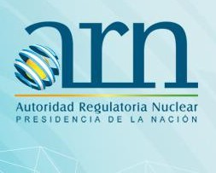
Tower House; 10 Southampton Street; WC2E 7HA - London, UK
Av. del Libertador 8250, Buenos Aires
Argentina
Thank you!
+44 20 7451 1520
+541163231757/8
patricia.wieland@world-nuclear.org, abel_j_gonzalez@yahoo.com
52
Notes:
52
52

